Slide 1




Performance benchmark
My implementation

Slide 2
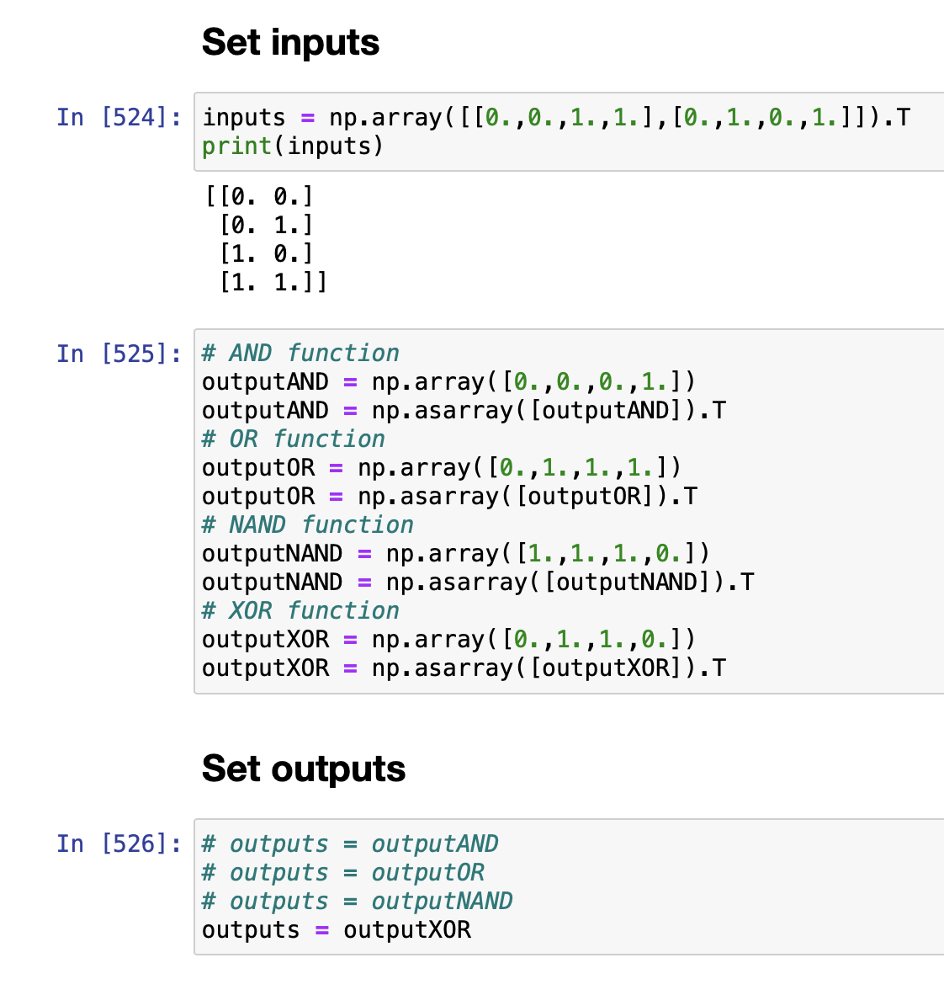
Simulating logic gates
4 sets of inputs of size=2
4 sets of single outputs of size=1

Slide 3
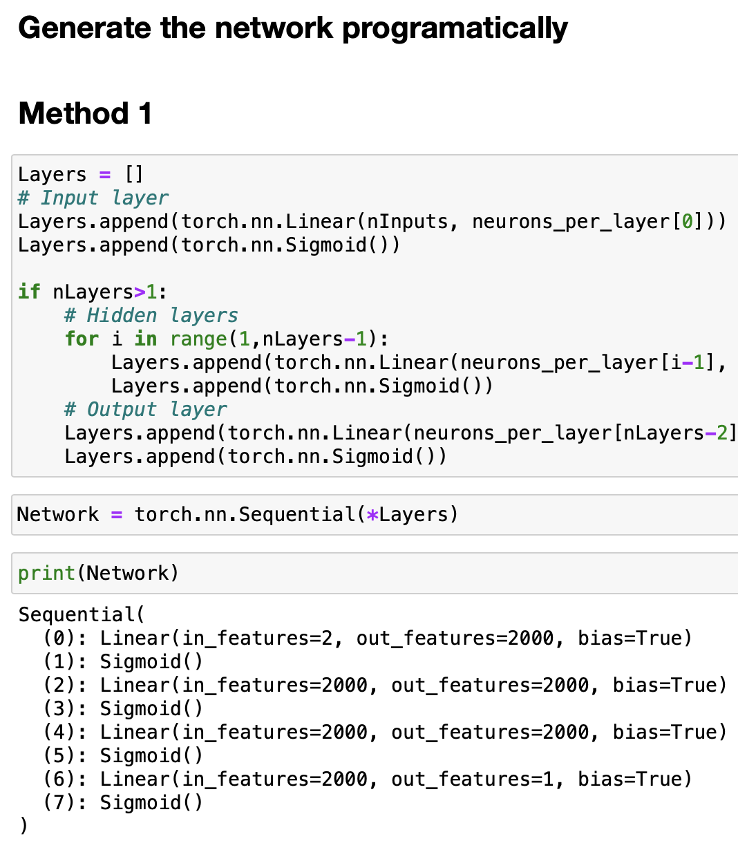
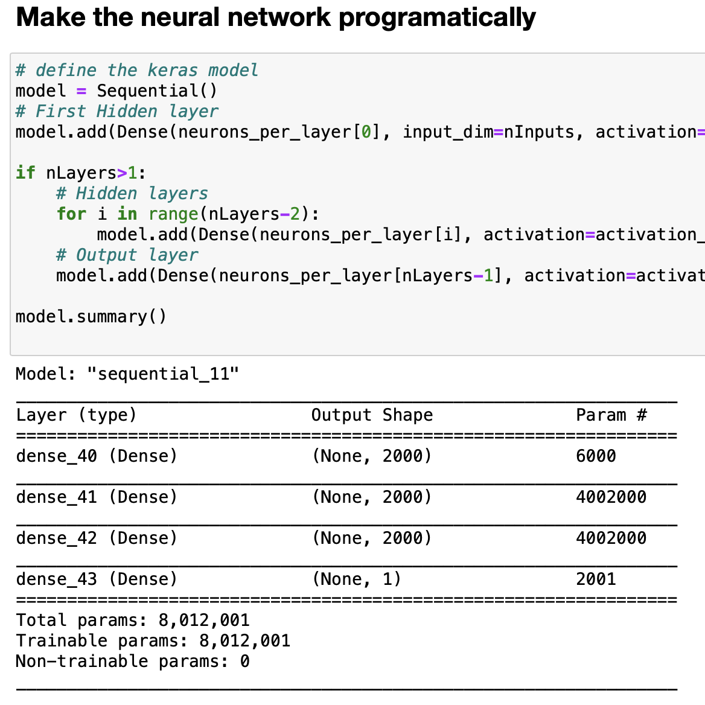
Benchmark process
PyTorch
All models are generated programatically based on the no. of layers and activations functions requested for each layer.
Initial weights and biases are generated using Keras and used for all other frameworks.
At the end the weights and biases from different frameworks are compared for consistency.
Both PyTorch and TF.keras were strictly CPU versions.
All use 32 bit arrays/tensors.
Keras

Slide 4
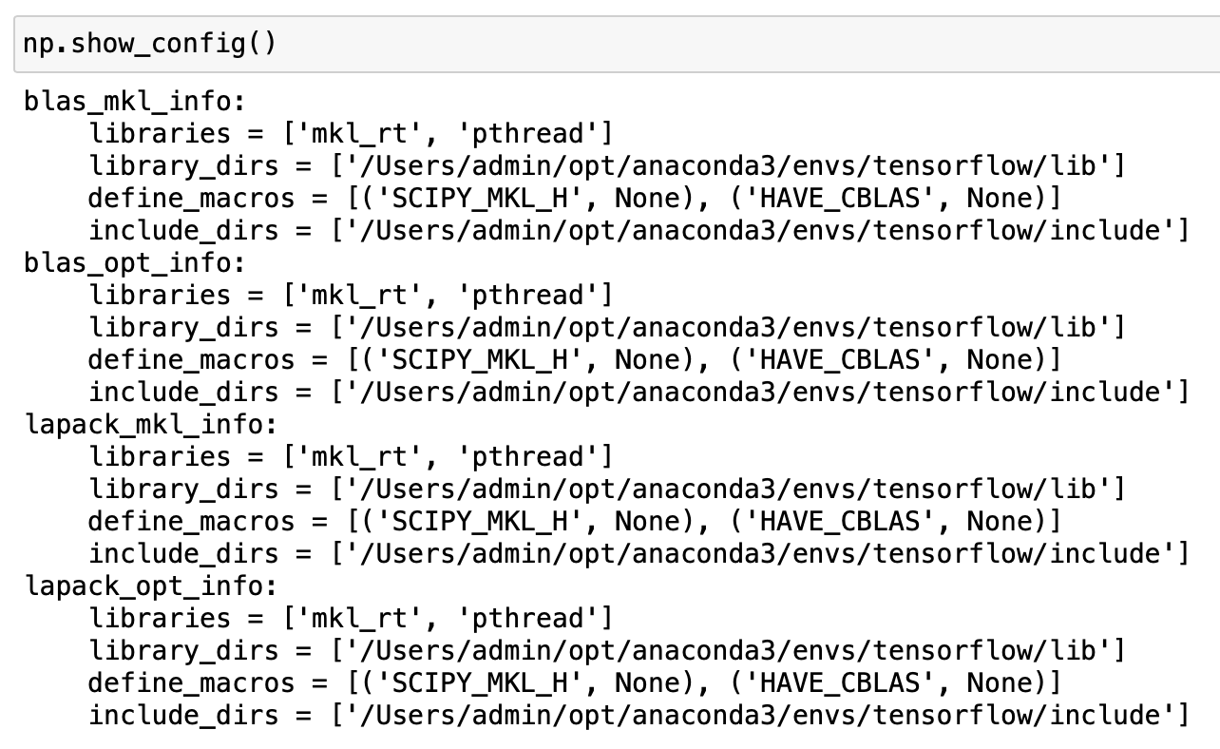

My Implementation
Use Numba to JIT compile the activation and loss functions as well as their derivatives.
Use matrix representation for batches.
Use opt_einsum for more efficient np.einsum.
Calculate the paths using opt_einsum expressions.
Numpy was linked with MKL (probably through PyTorch installation)

Slide 5
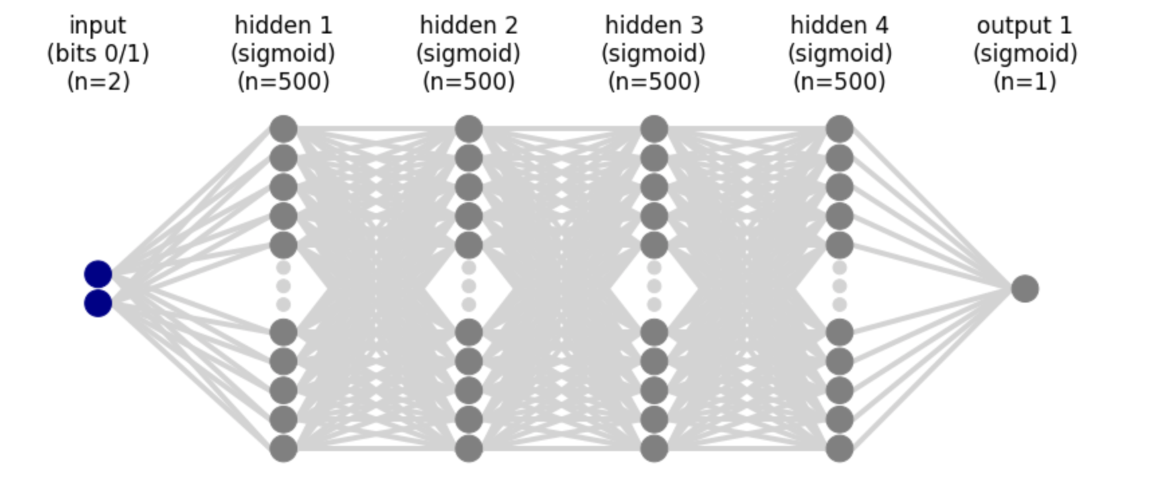
Multi-layered Neural network
Activation function: Sigmoid
Loss: MSE
SGD
nEpochs = 10,000
Learning rate = 0.5

Slide 6
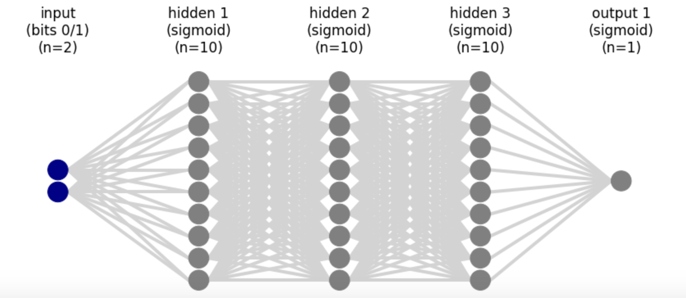
3 hidden layers with varying number of nodes
Wall Timings in seconds (4 CPU cores parallelized)
Model | No. of params | Tf.keras (600%) | Mine 1 | Mine 2 | PyTorch (600%) | Mine2/ Keras | Mine2/ PyTorch
10,10,10,1 | 261 | 26.8 | 2.89 | 6.01 | 10.2 | 0.22 | 0.59
50,50,50,1 | 5,301 | 31.4 | 3.79 | 7.73 | 11 | 0.24 | 0.70
100,100,100,1 | 20,601 | 34.7 | 3.43 | 7.6 | 9.74 | 0.22 | 0.78
500,500,500,1 | 503,001 | 62 | 36.6 | 35.8 | 41.4 | 0.58 | 0.86
1000,1000,1000,1 | 2,006,001 | 136 | 168 | 139 | 94 | 1.02 | 1.48
2000,2000,2000,1 | 8,012,001 | 328 | 765 | 648 | 368 | 1.98 | 1.76
XOR Gate
MacOS 10.15.4
I7 Quad core (6920 HQ) @ 2.9GHz
16 GB LPDDR3 RAM

Slide 7
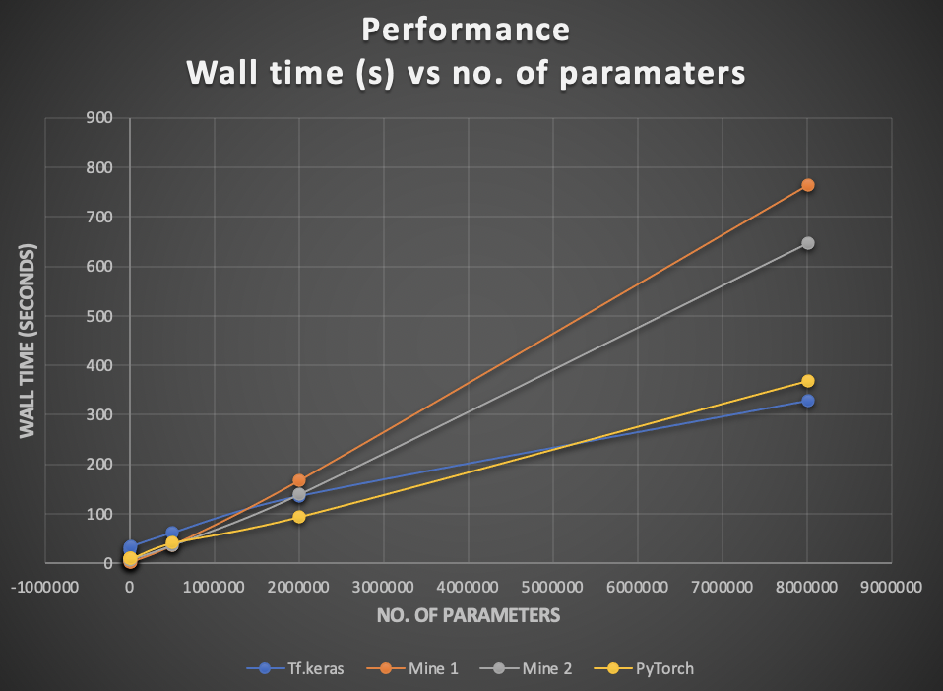
3 hidden layers with varying number of nodes
XOR Gate

Slide 8
Observations
Although, my implementation starts out faster, it gets overtaken by PyTorch and Tensorflow at around 2M parameters.
Tensorflow seems to spend around 20 seconds for some overhead task. Probably JIT compiling some code.
This is why I was faster than TF for smaller networks.
Both PyTorch and Tensorflow were using around 650% CPU resources on a 4-core 8-thread machine. While my implementations were only using 380%.
Unfortunately couldn’t modify the num_threads for PyTorch.
If I used 8 threads for my implementation, the CPU usage was upto 650% but the timings were not improved.

Slide 9
Varying no. of hidden layers with 500 nodes each
Wall Timings in seconds (4 CPU cores parallelized)
Model | No. of params | Tf.keras 600% | Mine 1 100%% | Mine 2 100% | PyTorch 600% | Mine2/ Keras | Mine2/ PyTorch
500,1 | 2,001 | 19.9 | 1.57 | 2.6 | 3.67 | 0.13065327 | 0.70844687
500,500,1 | 252,501 | 39.4 | 11.8 | 11.6 | 10 | 0.29441624 | 1.16
500,500,500,1 | 503,001 | 48 | 32.6 | 29.8 | 22.4 | 0.62083333 | 1.33035714
500,500,500,500,1 | 753,501 | 55.1 | 42.8 | 37.5 | 30.2 | 0.68058076 | 1.24172185
500,500,500,500,500,1 | 1,004,001 | 67 | 51 | 43.9 | 46.4 | 0.65522388 | 0.94612069
500,500,500,500,500,500,1 | 1,254,501 | 68 | 62 | 51.4 | 60 | 0.75588235 | 0.85666667
500,500,500,500,500,500,500,1 | 1,505,001 | 76 | 71 | 60 | 64 | 0.78947368 | 0.9375
XOR Gate
MacOS 10.15.4
I7 Quad core (6920 HQ) @ 2.9GHz
16 GB LPDDR3 RAM

Slide 10
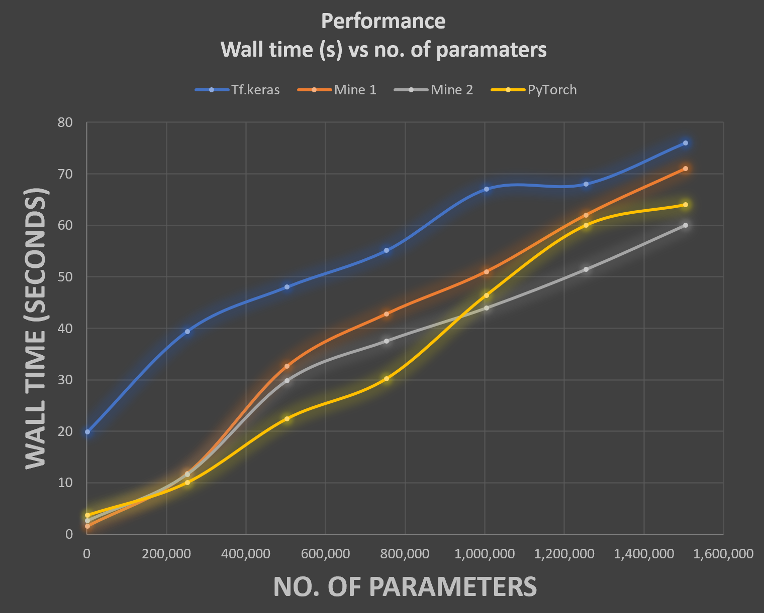
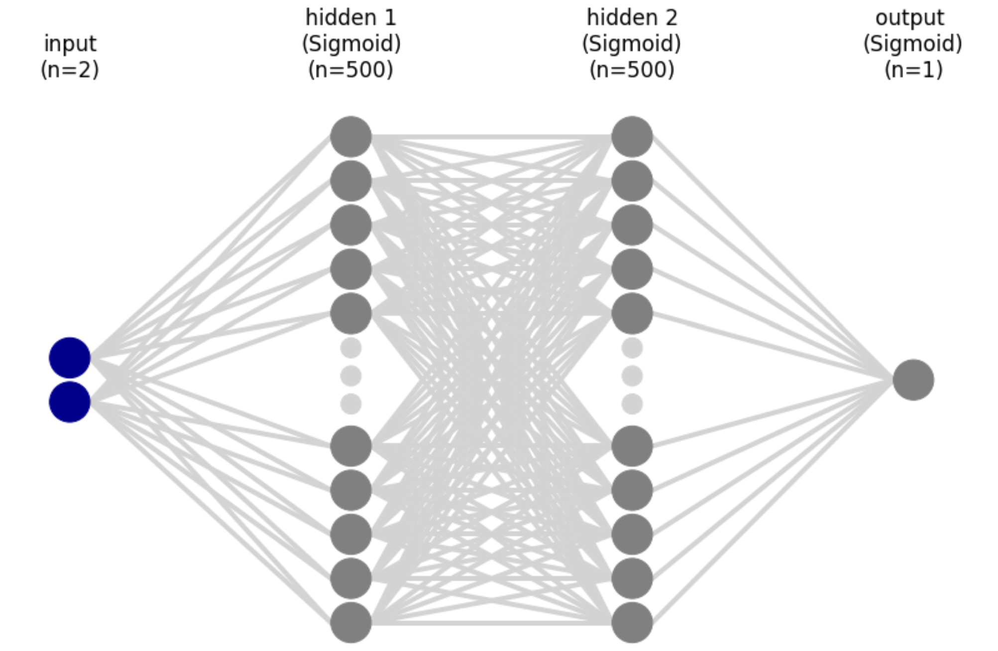
Varying no. of hidden layers with 500 nodes each
XOR Gate

Slide 11
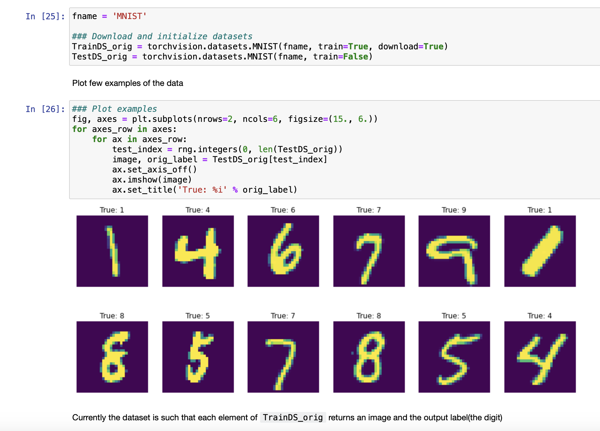
Digit classification MNIST
Input size = 28x28=784
Training size = 60,000
Batch size = 1875
nBatches = 32
Output size = 10

Slide 12
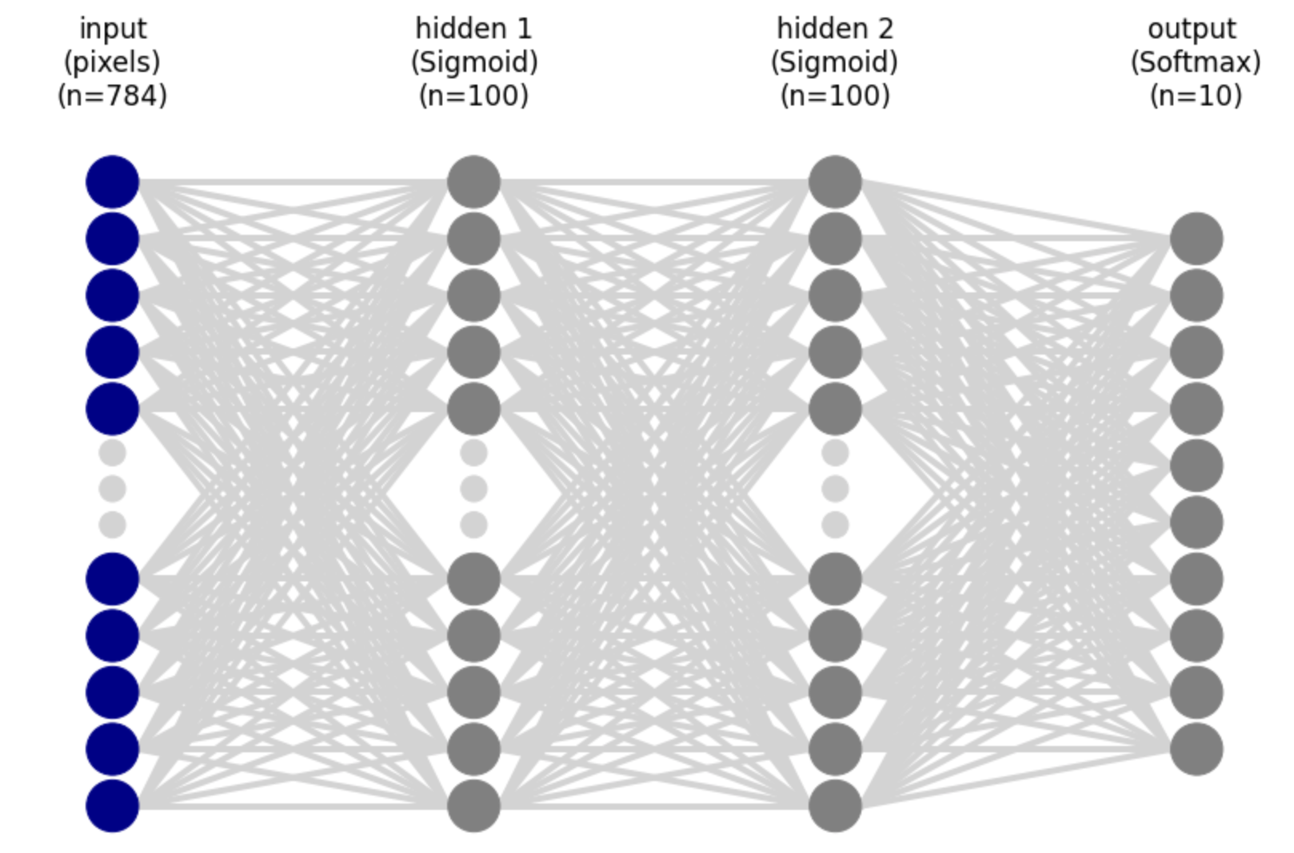
Multi-layered Neural network
Activation functions: Sigmoid and Softmax
Loss: MSE
SGD
nEpochs = 10
Learning rate = 0.5

Slide 13
3 hidden layers with varying number of nodes
Wall Timings in seconds
Model | No. of params | Tf.keras 700% | Mine 1 100%% | Mine 2 100% | PyTorch 650% | Mine2/ Keras | Mine2/ PyTorch
10,10,10 | 8,070 | 41 | 14.5 | 17.7 | 16.8 | 0.43170732 | 1.05357143
50,50,10 | 42,310 | 53.1 | 26.7 | 26.5 | 19.8 | 0.49905838 | 1.33838384
100,100,10 | 89,610 | 60 | 54.2 | 34.9 | 24.8 | 0.58166667 | 1.40725806
500,500,10 | 648,010 | 107 | 379 | 138 | 75 | 1.28971963 | 1.84
700,700,1 | 1,047,210 | 148 | 431 | 218 | 103 | 1.47297297 | 2.11650485
1000,1000,10 | 1,796,010 | 171 | 758 | 421 | 158 | 2.4619883 | 2.66455696
MNIST
MacOS 10.15.4
I7 Quad core (6920 HQ) @ 2.9GHz
16 GB LPDDR3 RAM

Slide 14

Thoughts on parallelization
Parallelization over batch size is much better in TF and PyTorch.
When increasing batchSize to 200 their performance was even faster than before with batchSize=32, increasing the difference further.
Unfortunately, parallelizing over the samples in a batch doesn’t give me any advantage for some reason.
If anything it makes it worse.

